Slide 1
Echo services with TCP and UDP.
By Safa Shafat

Slide 2
Difference between the Protocols
TCP
Provide reliable stream service
Uses the connection instead of protocol port, connections are identified by a pair of endpoints
Because of this, a given TCP port number can be shared by multiple connections on the same machine
UDP
Unreliable; messages can be lost, duplicated or arrive out of order, uses best-effort
Connectionless delivery service
Uses IP to carry messages, but adds the ability to distinguish among multiples destinations within a given host

Slide 3
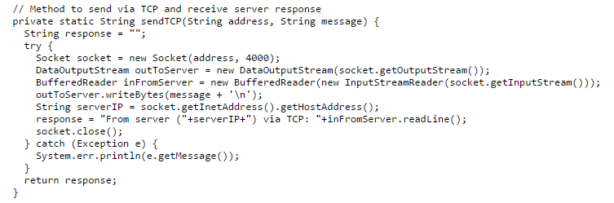
TCP Implementation
Java’s Socket uses the TCP protocol to deliver messages.
In the method sendTCP(), a new Socket is created on port 4000, which waits for a client to connect to server and then echoes the message back to the client by TCP.

Slide 4
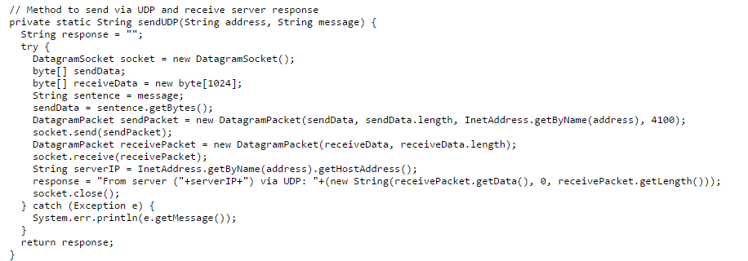
UDP Implementation
Java’s DatagramSocket uses the UDP protocol to deliver messages.
In the method sendUDP(), a new DatagramSocket is created on port 4100, which waits for a client to connect to server and then echoes the message back to the client via UDP.

Slide 5
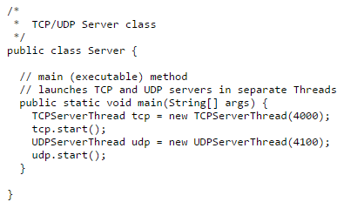
Server
Server Class creates the two Server Threads for different protocols to use
TCPServerThread is created for TCP use
UDPServerThread is used for UDP
The rest of the program contains the methods for the threads.

Slide 6
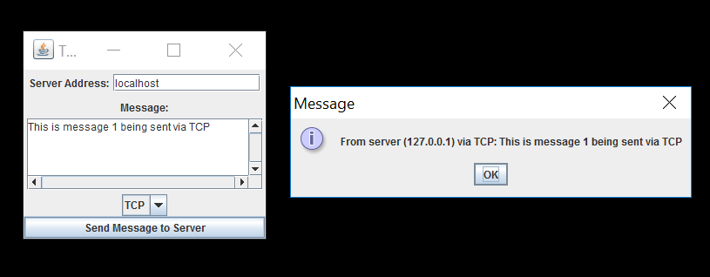
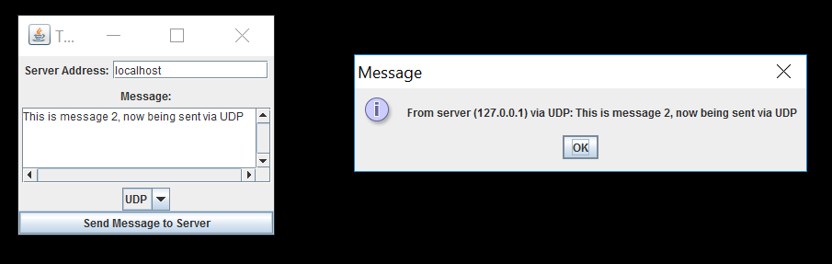
Client
Client creates a Graphics
User Interface
Server Address is set to
localhost or 127.0.0.1
Message box allows user
to send message to server
A JComboBox is used to
give user the protocol
choice to send message
Once selected, and send
button is clicked, message
is sent to server and echoed
back to a client, and viewed
on a popup prompt.

